Slide 1
Capstone 3
Mark Perez

Slide 2

Overview
IMDB Dataset
50K reviews
Use NLP for prediction

Slide 3
Why is it important?
Sentiment analysis is an important technique for natural language processing
Models focus on polarity, emotions, or intentions
Helps businesses make decisions

Slide 4
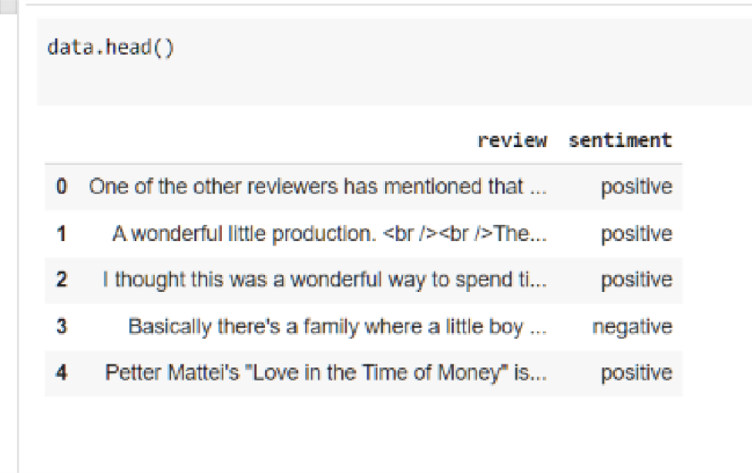
EDA

Slide 5
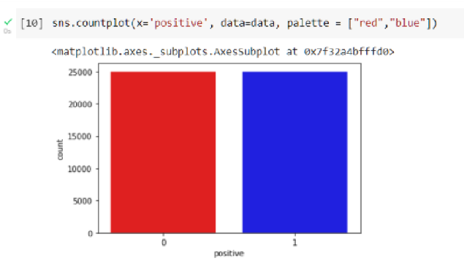
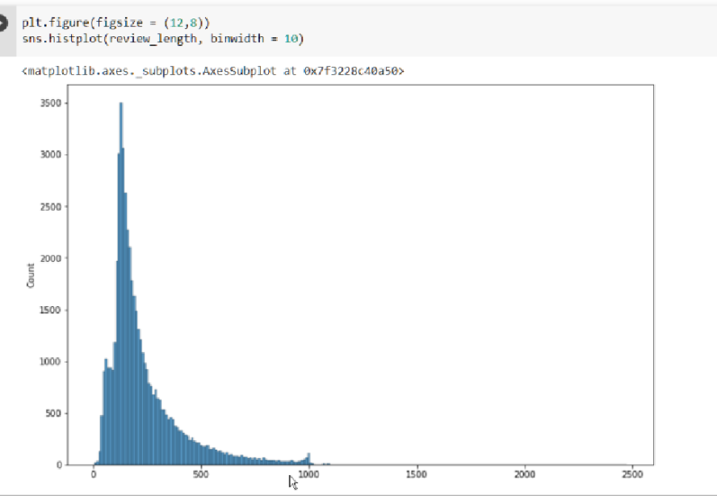

Slide 6
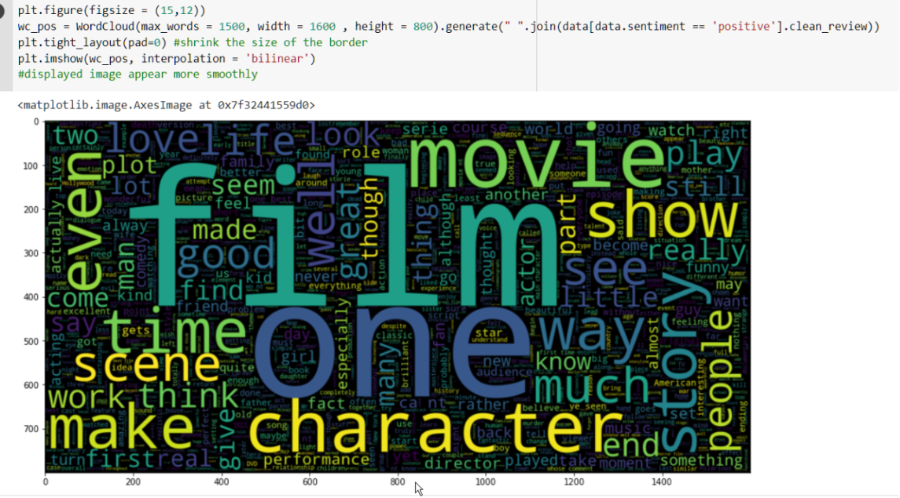

Slide 7
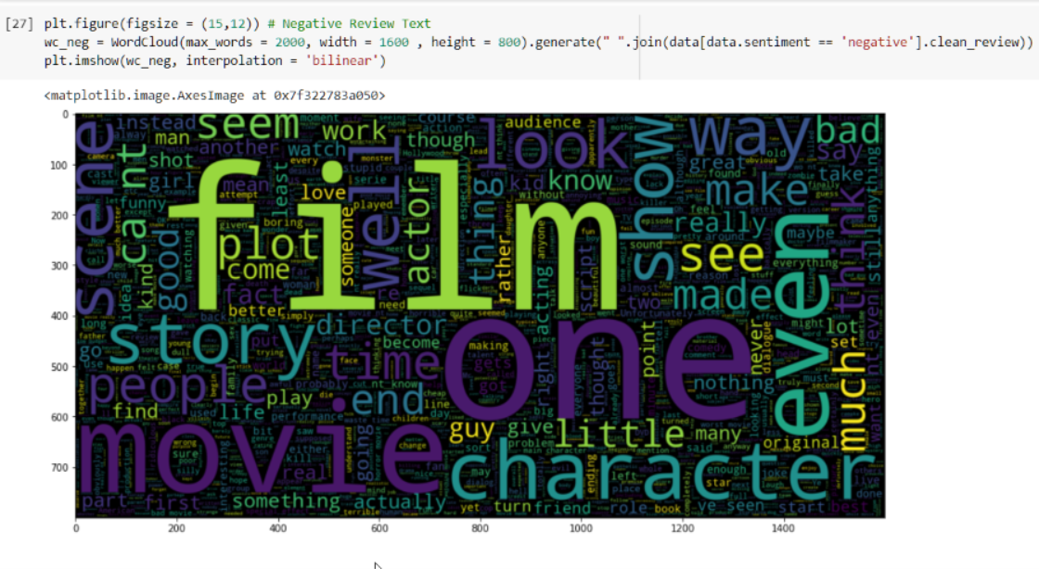

Slide 8
Modeling
Two models for Binary Classification:
Decision Tree Classifier & BERT

Slide 9
Decision Tree Classifier
Simple to prepare and understand
 | Precision | Recall | F1-score | Accuracy
0 | .82 | .6 | .69
1 | .47 | .73 | .57
 |  |  |  | .64

Slide 10


What is BERT?
Bidirectional Encoder Representations from Transformers
Each word is contextualized based on the other words in the sentence.
Different versions of BERT
Text Encoding Similarity Retrieval
Text Summarization

Slide 11
How BERT works
BERT relies on a Transformer
The input for the encoder are three embedings: Token, Segment, and Positional
BERT’s language modeling task (MLM) masks 15% of words in the input and asks the model to predict the missing word, as well as predict whether a following sentence (after a SEP token) is random or not.

Slide 12
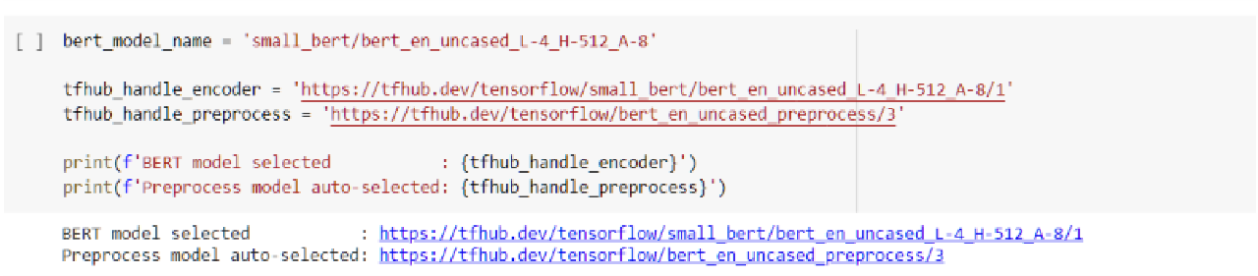
Beauty of Tensorflow
TensorFlow Hub is a repository for trained machine learning models
We load the preprocessing model (to prepare the text) and the model (small BERT) from TF Hub.

Slide 13
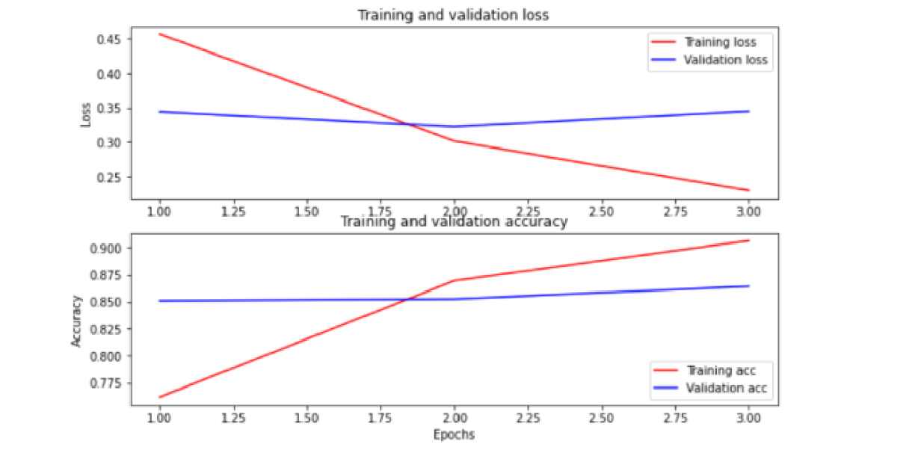
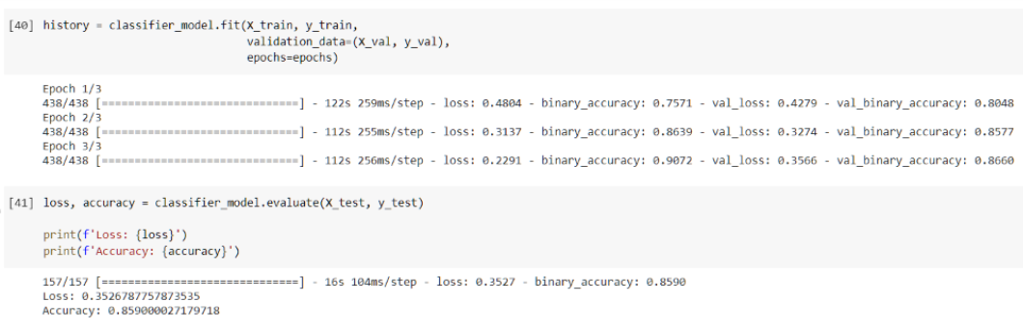
Results

Slide 14
Conclusion
BERT Model is great at Sentiment analysis
Accuracy increased by about 22%
Accuracy is not always the best metric to measure

Slide 15
Further Analysis and Constraints
More data
Compare other models (Random Forest and LSTM)
Fine tuning

